Slide 1
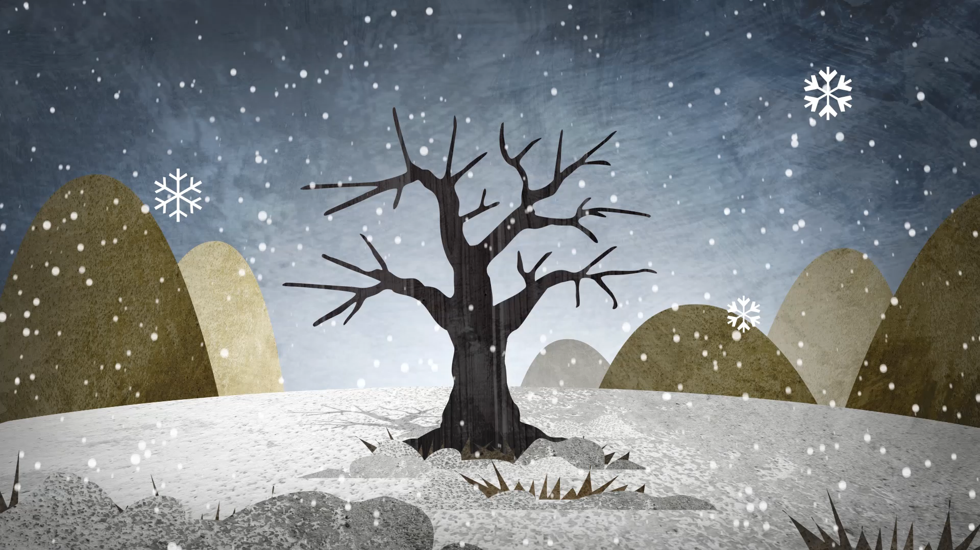
Forest Cover Type Prediction
By,
Chirag Chandrashekar

Slide 2
Index
Dataset
Pre-processing dataset
Features of dataset
Correlation Matrix
Pair plot for highly correlated features
Standardizing the data
Implementing Logistic Regression
Implementing Neural Network
Applying PCA
Bagging
Conclusion

Slide 3
Dataset
Kaggle: Forest Cover Type Dataset
1. This dataset contains tree observations from four areas of the Roosevelt National Forest in Colorado.
2. All observations are cartographic variables from 30-meter x 30-meter sections of the forest.
3. This dataset includes information on tree type, shadow coverage, distance to nearby landmarks, soil type, and local topography.

Slide 4
Pre-processing dataset
1. Duplicate entries have been eliminated.
2. All missing values(NA) have been taken care of.
3. The dataset has been divided into training and test sets with an 80-20 ratio.

Slide 5
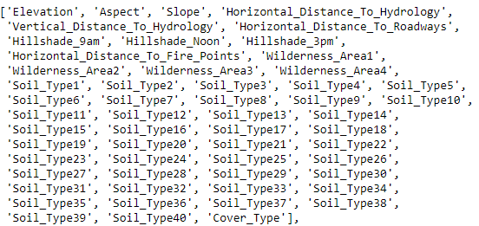
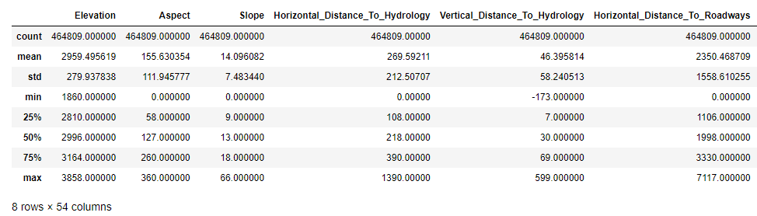
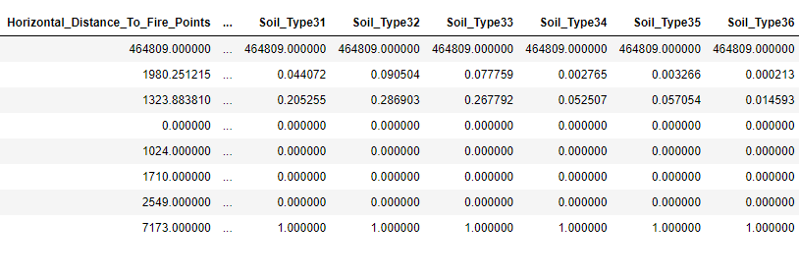
Features of Dataset
Description of the Training Dataset

Slide 6
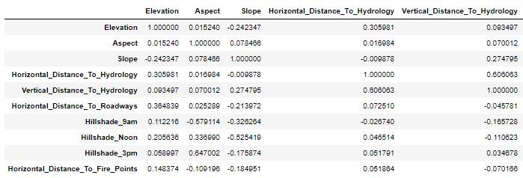
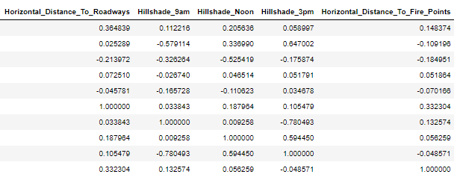
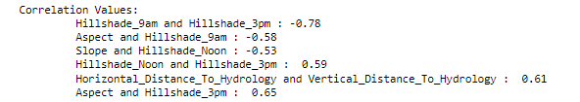
Correlation Matrix

Slide 7
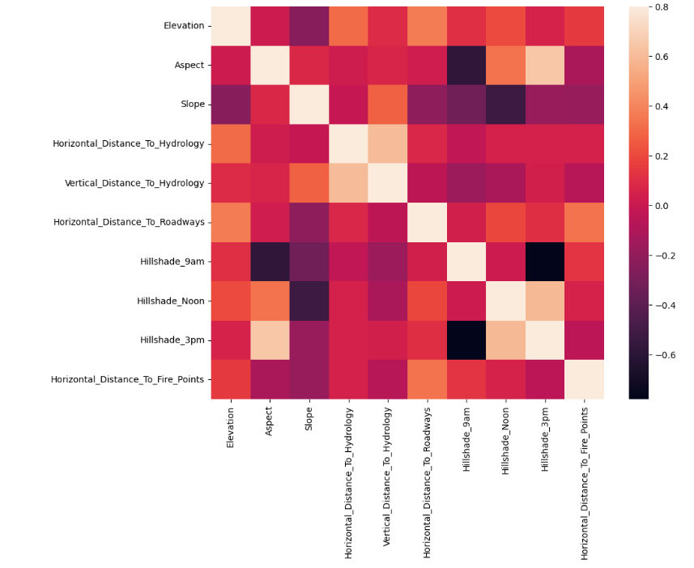
Heat Map

Slide 8
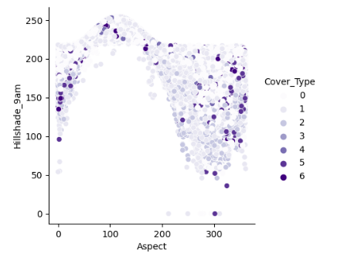
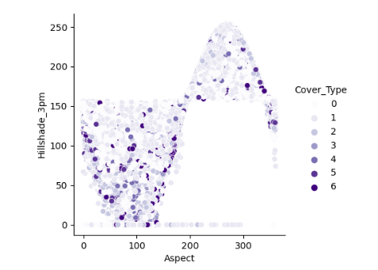
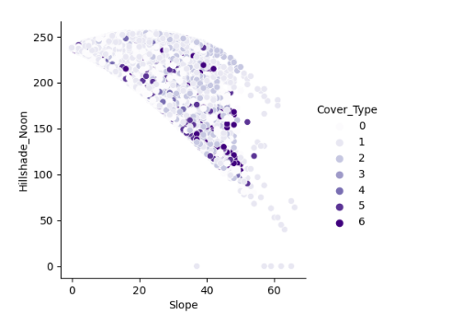
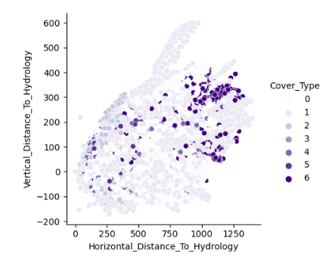
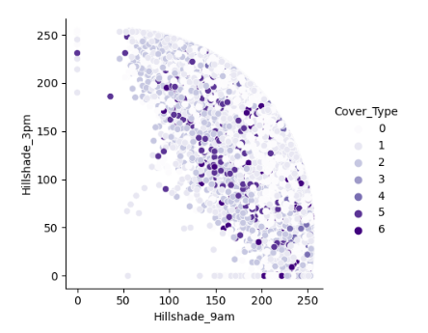
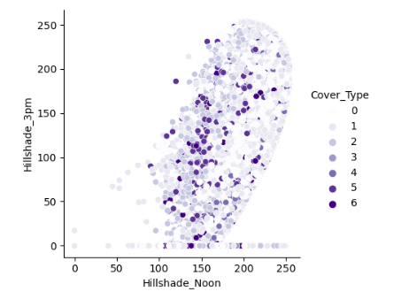
Pair plot for highly correlated features

Slide 9

Standardizing the data
Standardizing helps to ensure that the data are on a similar scale.
It transforms the data such that it has a mean of 0 and a standard deviation of 1.

Slide 10

Test data accuracy: 72.32
Training data accuracy: 72.46
Predicting data using Logistic Regression
Test data accuracy: 87.17
Training data accuracy: 87.65
Predicting data using Neural Network

Slide 11
Predicting data after applying PCA(Principal Component Analysis)
Test data accuracy: 53.92
Training data accuracy: 53.85

Slide 12
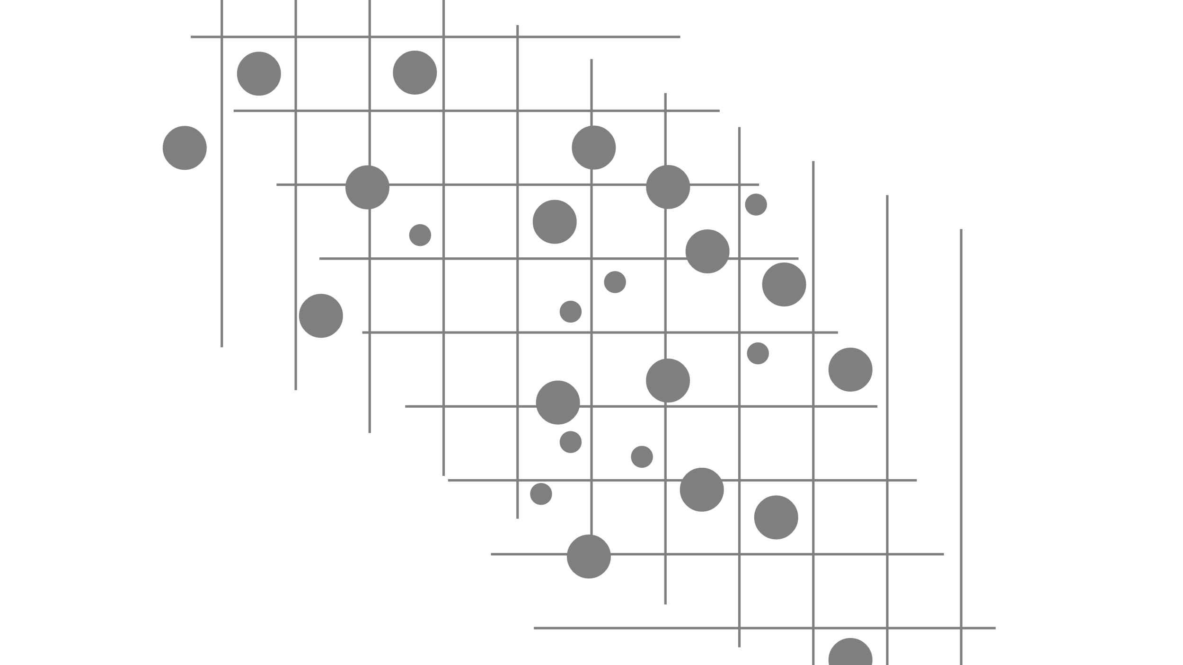
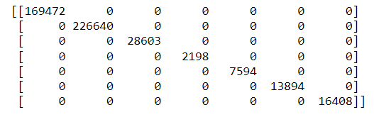
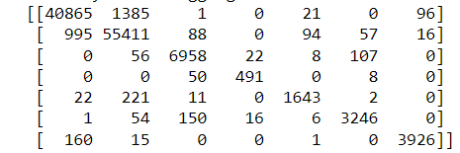
Predicting data after applying Bagging
Test data accuracy: 96.85
Training data accuracy: 100

Slide 13
Conclusion
Considering the results obtained from different classifications, bagging gave the best result for the cover type prediction.
Neural network also gives considerably good results.
PCA will lead to a lot of data loss, so if the features are very much dependent on each other then it would not be an ideal method to implement.

Slide 14
Future Scope….
Implementing Neural Network from scratch.

Slide 15


Thankyou

